Slide 1
Nature and Scope of Macroeconomic
Macroeconomics studies how the large aggregates such as total employment, national product or national income of an economy and the general price level are determined. Macroeconomics is therefore a study of aggregates. Besides, macroeconomics explains how the productive capacity and national income of the country increase over time in the long run

Slide 2
The Classical Economists and Classical Economists
Say’s Law of Markets The belief of classical economists that full employment of labor and capital stock will always exist was based on Say’s Law of Markets. According to Say’s Law, supply creates its own demand and, therefore, the problem of lack of demand for supply of goods and services does not arise
Keynesian Revolution
During the Great Depression of 1930s unemployed remained at a high level for nearly 10 years.
A General Theory of Employment, Interest and Money, published in 1936
He showed how the equilibrium level of national income and employment was determined by aggregate demand and aggregate supply and further that due to lack of aggregate effective demand equilibrium level of income and employment

Slide 3
THE MAJOR ISSUES AND CONCERNS OF MACROECONOMICS
The Problem of Unemployment
Recession and Determination of National Income (or GNP)
Problem of Inflation
Business Cycles
Stagflation
Economic Growth
Balance of Payments and Exchange Rate.

Slide 4
THE ROLE OF GOVERNMENT IN THE MACROECONOMY
There are three types of economic policy that are used by the government to influence the working of macro economy:
Fiscal Policy
Monetary Policy
Supply-Side Policies

Slide 5
Circular Flow of Income and National Income Accounting
National income of a country can be defined as the total market value of all final goods and services produced in the economy in a year.
Two things must be noted in regard to this meaning of national income.
First, it measures the market value of annual output. In other words, national income is a monetary measure.
Second, national income only includes the market value of all final goods and ignores the transactions involving intermediate goods.

Slide 6
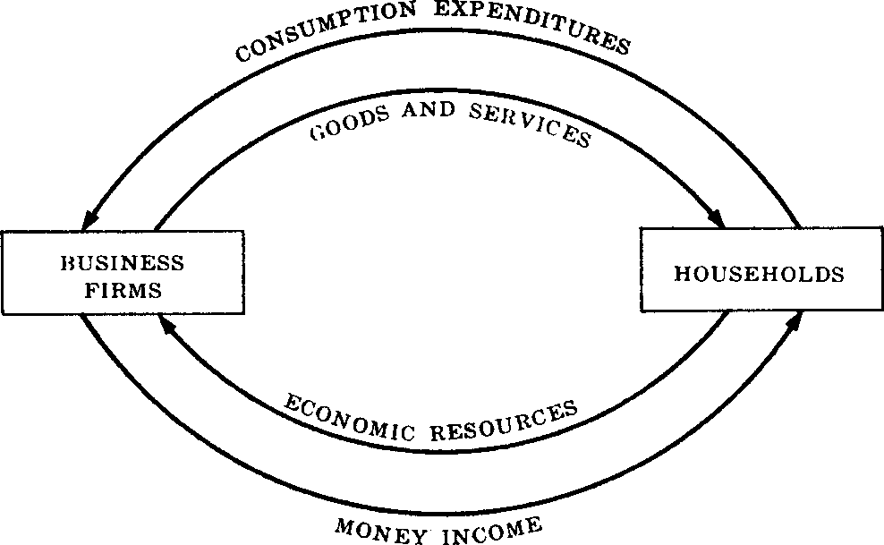
CIRCULAR FLOW OF INCOME
Circular Money Flow with Saving and Investment
Y ≡ C + I
Y ≡ C + S
C + I ≡ Y ≡ C + S

Slide 7
CONCEPTS OF NATIONAL INCOME
Gross Domestic Product (GDP)
Gross Domestic Product is defined as the total market value of all final goods and services produced in a year in the domestic territory of a country.
GDP = C + I + G + NX
where NX = (X – M)
Gross Domestic product has the following components :
Value of final consumer goods and services produced in a year and consumed by the households which is denoted by consumption (C) by households.
Value of new capital goods produced and addition to the inventories of goods such as raw materials, unfinished goods and consumer goods produced but not sold during a year. This is called Gross Private Investment (I)
Value of output of General Government which is taken to be equal to the value of purchases of goods and services by the Government which we denote by G.
Net Exports (NX) which is equal to value of goods exported minus the value of goods imported (M).
Thus, we can obtain Gross Domestic Product (GDP) by adding up the first four items of Gross National Product listed above. Thus

Slide 8
Continue…
Gross National Product (GNP)
Gross national product is the money value of all final goods and services produced by normal residents as well as non-residents in the domestic territory of a country and also not includes net factor income earned from abroad.
GNP = GDP + net factor income from abroad.
Net Factor Income from Abroad is the difference between factor income received from abroad by normal residents of a country for rendering factor services in other countries on the one hand and the factor incomes paid to the foreign residents for factor services rendered by them in the domestic territory of a country on the other

Slide 9
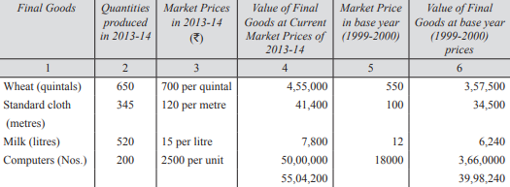
NOMINAL GNP AND REAL GNP
Economists evaluate the output of final goods and services produced in a year using the market prices that prevailed in a certain chosen year, called as the base year.
GNP Deflator = [(Nominal GNP of a year)/(Real GNP of the year) ]x 100.
Besides, by calculating the percentage change of real GNP in a year enables us to measure rate of economic growth in a year

Slide 10
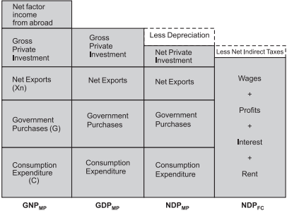
National Income Measurement

Slide 11
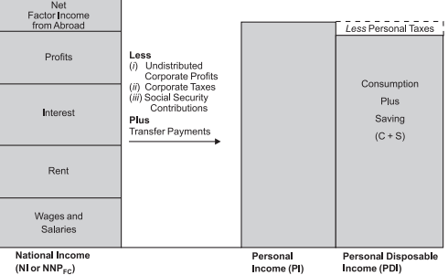
National Income Measurement

Slide 12
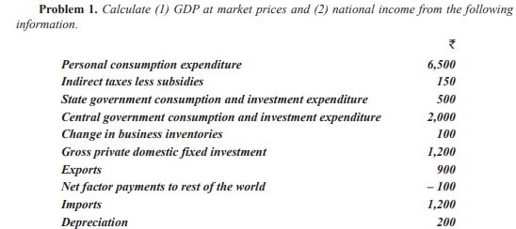
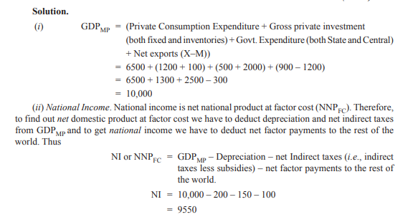
Problem and solutions
Solution

Slide 13
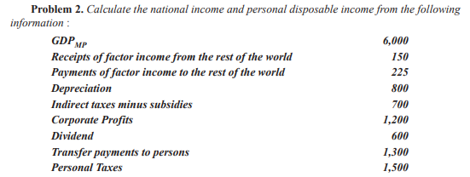
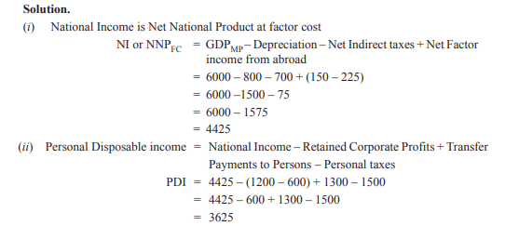
Problem and Solution
Solution

Slide 14
The consumption function is a fundamental concept in economics, particularly in macroeconomics. It describes the relationship between consumption expenditure and disposable income (income after taxes). The consumption function shows how much households plan to consume at various levels of disposable income, holding other factors constant.
General Form of the Consumption Function
The consumption function can be written as:
C= a + bYd
Where:
C: Total consumption.
a: Autonomous consumption (the amount of consumption when disposable income is zero; consumption financed through savings or borrowing).
b: Marginal propensity to consume (MPC), which is the fraction of additional disposable income spent on consumption (0<b<1).
Yd: Disposable income.
Key Concepts
Autonomous Consumption (a):
This is the level of consumption that occurs even when income is zero. It reflects basic needs financed through savings, credit, or government assistance.
Marginal Propensity to Consume (b):
The MPC indicates how much of an additional dollar of income is spent on consumption. For example, if MPC=0.8MPC = 0.8MPC=0.8, it means 80% of additional income is spent, while the remaining 20% is saved.
Disposable Income (Yd):
This is the income available to households after taxes and transfers are accounted for.

